Slide 1


Binomial models

Slide 2
28/05/2026
Data types and model selection
Multinomial
Multinominal logit regression
In some cases, this framework is unsuitable, requiring the use of alternative methods
Ordered
Ordered logit regression
Categorical
Binary
Logit/probit regression
Linear probability
Numerical
Time to event
Cox proportional hazards model
Outcome variable
Continuous
Linear regression
Objective
Data structure
Count
Poisson regression
Covariates
Negative binomial regression
Proportion
Beta regression
Cross section
Time series
Panel
Repeated cross section
Data analysis

Slide 3
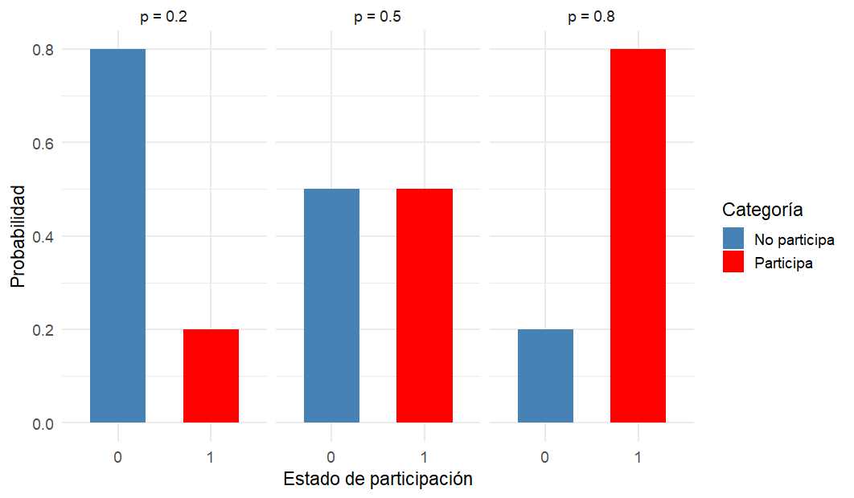
28/05/2026
Binomial Models
A binomial response variable can take only two mutually exclusive values, typically coded as 0 and 1.
Bernoulli distribution
Familias en acción
Probability
Categories
For such variables, the relevant statistical distribution is a binomial distribution with a single trial.
Probability
out
in
Participation
Therefore, in this context, one should not assume the distribution of the response variable; rather, the binomial framework inherently defines it.
Participation
Croissant, Y. (2024). Microeconometrics with R (1st ed.). Chapman and Hall/CRC. https://doi.org/10.1201/9781003100263
Cameron, A. C., & Trivedi, P. K. (2005). Microeconometrics: Methods and Applications (13th printing). Cambridge University Press.
Logit Regression | R Data Analysis Examples. (n.d.). Retrieved September 28, 2025, from https://stats.oarc.ucla.edu/r/dae/logit-regression/
Getting Started inLogit and OrderedLogit Regression. (n.d). Oscar Torres-Reyna. http://www.princeton.edu/~otorres/

Slide 4
28/05/2026
Binomial Models
A binomial response variable can take only two mutually exclusive values, typically coded as 0 and 1.
If we define the two possible outcomes of a random variable as:
1 as success
0 as failure
Then the distribution is fully characterised by a single parameter, μ, which represents the probability of success, p, and is also the expected value of the variable.
For such variables, the relevant statistical distribution is a binomial distribution with a single trial.
The variance of the binomial response is given by:
Therefore, in this context, one should not assume the distribution of the response variable; rather, the binomial framework inherently defines it.

Slide 5
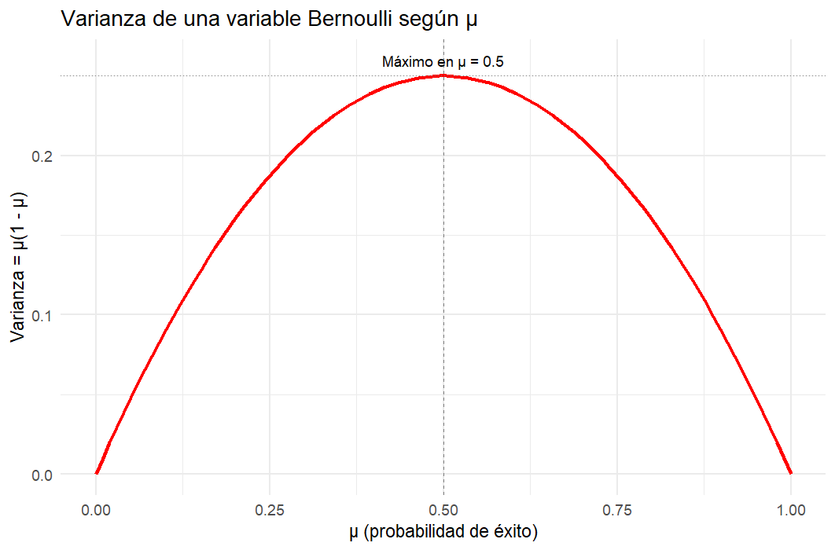
28/05/2026
Binomial Models
If we define the two possible outcomes of a random variable as:
1 as success
0 as failure
Then the distribution is fully characterised by a single parameter, μ, which represents the probability of success, p, and is also the expected value of the variable.
Variance of a Bernoulli distribution
Max: μ= 0.5
Variance: μ (1 - μ )
The variance of the binomial response is given by:
μ (probability of success)
As the mean of the variable approaches 1 or 0, the variance of Y tends towards zero.
This occurs because, in such extreme cases, almost all observed values in the sample will be either 1 or 0, leaving very little variability.

Slide 6
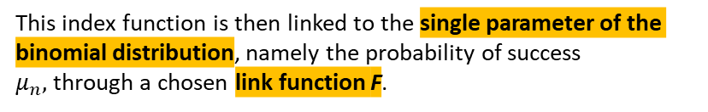
28/05/2026
Binomial Models
Index function
To construct a regression model for a binomial response, we first define an index function, also known as the linear predictor:
1.
Linear Probability Model
Uses the identity function as the link. Simple to estimate via OLS, but may produce probabilities outside the [0,1] interval.
2.
This index function is then linked to the single parameter of the binomial distribution, namely the probability of success $μ_{n},$through a chosen link function F.
Logit model
Uses the logistic cumulative distribution function as the link. Ensures probabilities remain between 0 and 1.
3.
Probir model
Different choices of the function F lead to different binomial models. After defining the index function, we select a function F that maps the linear predictor to the binomial probability.
Uses the standard normal cumulative distribution function as the link. Also ensures probabilities remain between 0 and 1.

Slide 7
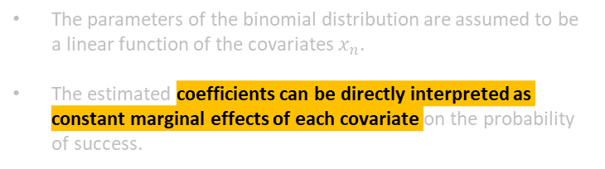
28/05/2026
Binomial Models
Linear probability model
🚫 Limitations
The most direct choice for the link function F is the identity function:
1.
Residual Structure
Because the outcome y takes only the values 0 or 1, the residual is mechanically related to the covariates:
This implies that the model can be estimated using the familiar Ordinary Least Squares (OLS) approach, given its linear structure. Since the model is linear:
The parameters of the binomial distribution are assumed to be a linear function of the covariates $x_{n}$.
The estimated coefficients can be directly interpreted as constant marginal effects of each covariate on the probability of success.
This creates correlation between the error term and the regressors, violating the OLS assumption of independence and affecting the consistency of the estimators. Additionally, the residual variance is heteroskedastic, which means:
OLS becomes inefficient
the reported standard errors are biased, unless corrected.

Slide 8
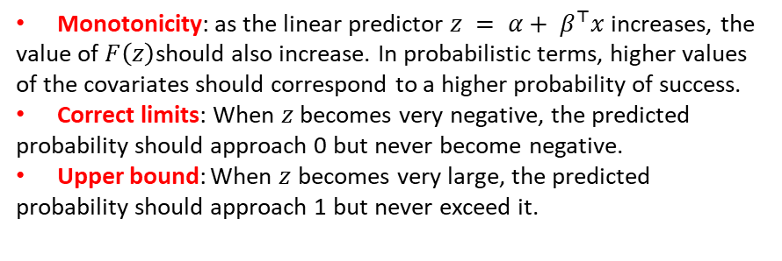
28/05/2026
Binomial Models
Linear probability model
🚫 Limitations
The most direct choice for the link function F is the identity function:
2.
Predicted probabilities may fall outside [0,1]
Since the identity function does not constrain predictions, the model may produce:
Probabilities below 0
Probabilities above 1
This implies that the model can be estimated using the familiar Ordinary Least Squares (OLS) approach, given its linear structure. Since the model is linear:
Which are not meaningful for a probability model. Therefore, we typically prefer a link function F that ensures all predicted values lie within the [0,1] interval.
Monotonicity: as the linear predictor $z = α+ β^{⊤}x$ increases, the value of $F\left(z\right)$should also increase. In probabilistic terms, higher values of the covariates should correspond to a higher probability of success.
Correct limits: When $z$ becomes very negative, the predicted probability should approach 0 but never become negative.
Upper bound: When $z$ becomes very large, the predicted probability should approach 1 but never exceed it.
The parameters of the binomial distribution are assumed to be a linear function of the covariates $x_{n}$.
The estimated coefficients can be directly interpreted as constant marginal effects of each covariate on the probability of success.

Slide 9
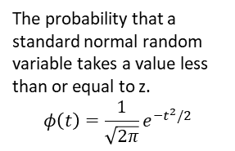
28/05/2026
Binomial Models
Motivation for Non‑Linear Models
These issues motivate the use of alternative link functions which form the basis of logit and probit models. These models guarantee that predicted probabilities always remain in the valid range and are therefore more appropriate for binary outcomes.
Normal function
Logistic function
The probability that a standard normal random variable takes a value less than or equal to z.
Indicates that we are accumulating the area under the density curve from minus infinity up to z.
It is the exponential function applied to the linear predictor z.T he denominator grows rapidly as z increases and tends towards zero as z decreases.
The probability that a standard normal random variable takes a value less than or equal to z.
$$φ\left(t\right)=\frac{1}{\sqrt{2π}}e^{−t^{2}/2}$$
The denominator that normalises the exponential growth, ensuring that the result lies between 0 and 1.
Notes:
No existe una forma cerrada para la función normal. Por eso:
Se deja expresada como una integral.
Su evaluación requiere métodos numéricos o tablas precomputadas.
En modelos probit, se usa esta forma acumulada para mapear el predictor lineal a una probabilidad.

Slide 10
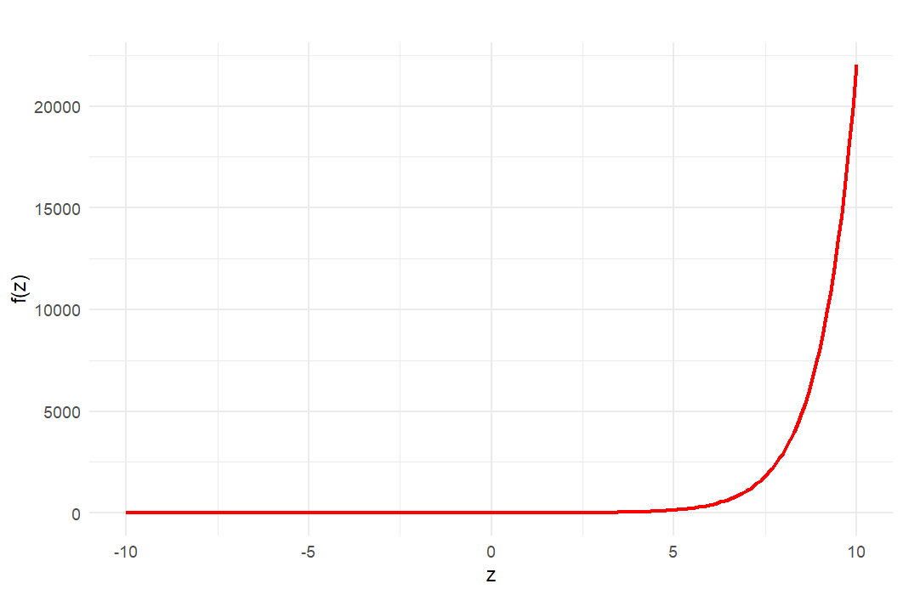
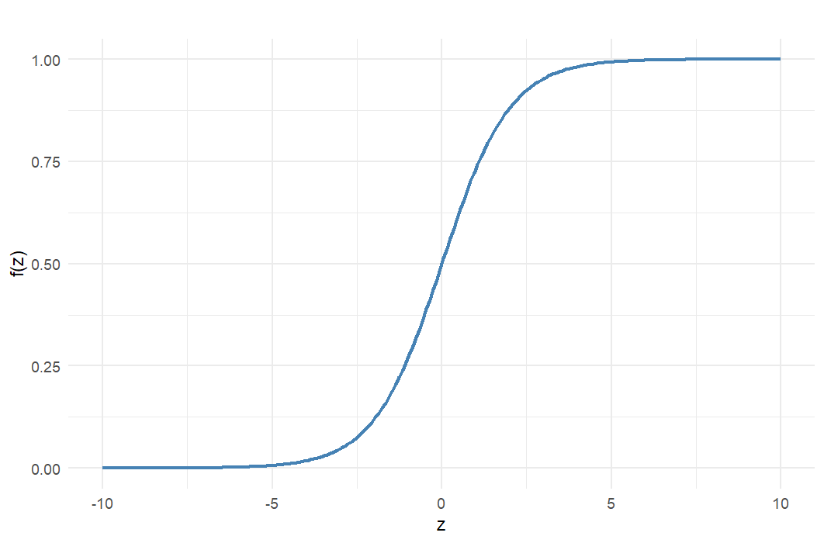
28/05/2026
Binomial Models
Logistic function
Notes:
No existe una forma cerrada para la función normal. Por eso:
Se deja expresada como una integral.
Su evaluación requiere métodos numéricos o tablas precomputadas.
En modelos probit, se usa esta forma acumulada para mapear el predictor lineal a una probabilidad.

Slide 11
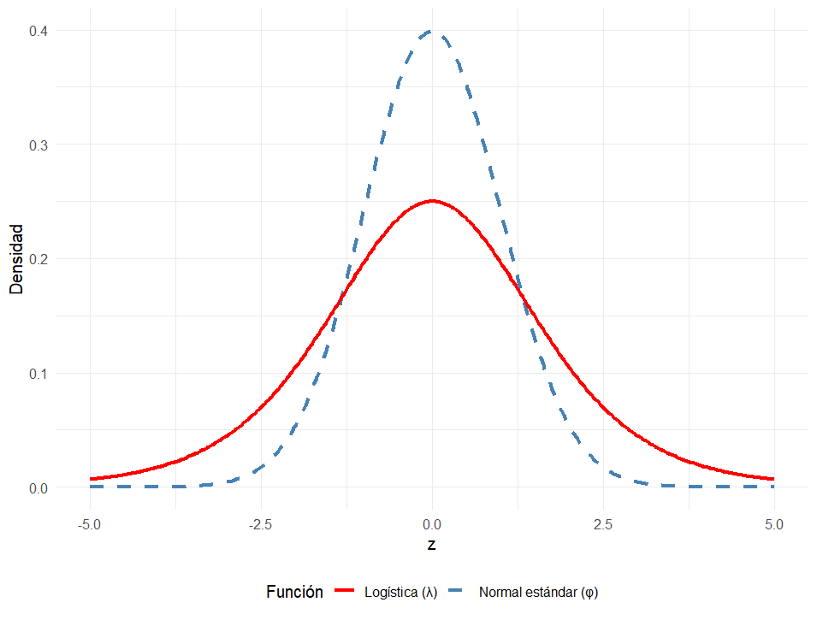
28/05/2026
Binomial Models
Logit and Probit models
Density Functions: Normal vs Logistic
Key Differences Between the Normal and Logistic Densities
The logistic distribution has a larger variance, which means its density is more spread out.
In practice, it assigns more probability to values farther from the centre. Because of that, the logistic density has heavier tails than the standard normal density.
Density
Because the logistic density has heavier tails, it assigns relatively more probability to extreme values of the predictor z compared with the probit model.
Function
Logistic
Normal Standard
Notes:
No existe una forma cerrada para la función normal. Por eso:
Se deja expresada como una integral.
Su evaluación requiere métodos numéricos o tablas precomputadas.
En modelos probit, se usa esta forma acumulada para mapear el predictor lineal a una probabilidad.
Estas son funciones de distribucion acumulada.

Slide 12
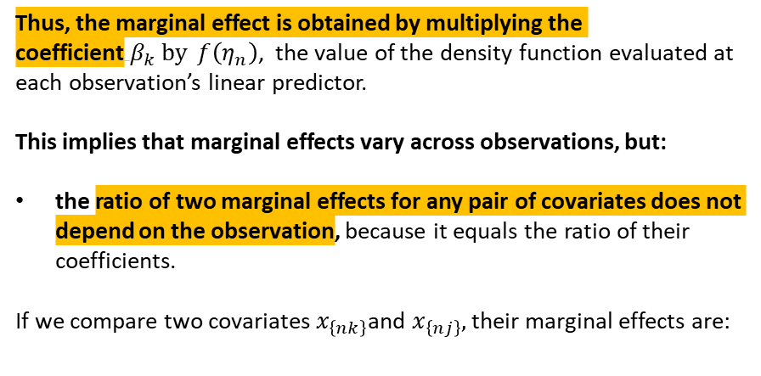
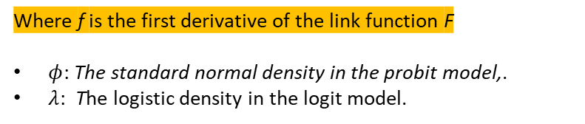
28/05/2026
Binomial Models
Logit and Probit models
Thus, the marginal effect is obtained by multiplying the coefficient$β_{k} by$ $f\left(η_{n}\right)$, the value of the density function evaluated at each observation’s linear predictor.
This implies that marginal effects vary across observations, but:
the ratio of two marginal effects for any pair of covariates does not depend on the observation, because it equals the ratio of their coefficients.
If we compare two covariates $x_{\left\{nk\right\}}$and $x_{\left\{nj\right\}},$their marginal effects are:
Given:
the k-th covariate changes, its marginal effect on the probability is given by:
Where f is the first derivative of the link function F
$φ$: The standard normal density in the probit model,.
$λ$: The logistic density in the logit model.
Then The ratio is independent of the specific values of the covariates for observation n :
Notes:
No existe una forma cerrada para la función normal. Por eso:
Se deja expresada como una integral.
Su evaluación requiere métodos numéricos o tablas precomputadas.
En modelos probit, se usa esta forma acumulada para mapear el predictor lineal a una probabilidad.
Estas son funciones de distribucion acumulada.

Slide 13

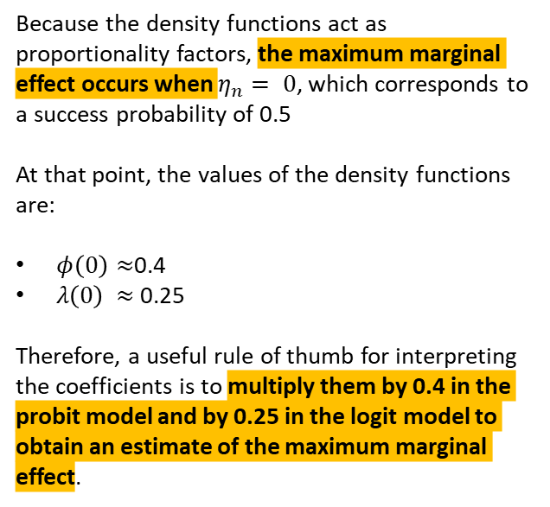
28/05/2026
Binomial Models
Logit and Probit models
Thus, the marginal effect is obtained by multiplying the coefficient$β_{k} by$ $f\left(η_{n}\right)$, the value of the density function evaluated at each observation’s linear predictor.
This implies that marginal effects vary across observations, but:
the ratio of two marginal effects for any pair of covariates does not depend on the observation, because it equals the ratio of their coefficients.
If we compare two covariates $x_{\left\{nk\right\}}$and $x_{\left\{nj\right\}},$their marginal effects are:
Because the density functions act as proportionality factors, the maximum marginal effect occurs when $η_{n}= 0$, which corresponds to a success probability of 0.5
At that point, the values of the density functions are:
$φ\left(0\right)≈$0.4
$λ\left(0\right)$ $≈$0.25
Therefore, a useful rule of thumb for interpreting the coefficients is to multiply them by 0.4 in the probit model and by 0.25 in the logit model to obtain an estimate of the maximum marginal effect.
Then The ratio is independent of the specific values of the covariates for observation n :
Notes:
No existe una forma cerrada para la función normal. Por eso:
Se deja expresada como una integral.
Su evaluación requiere métodos numéricos o tablas precomputadas.
En modelos probit, se usa esta forma acumulada para mapear el predictor lineal a una probabilidad.
Estas son funciones de distribucion acumulada.

Slide 14
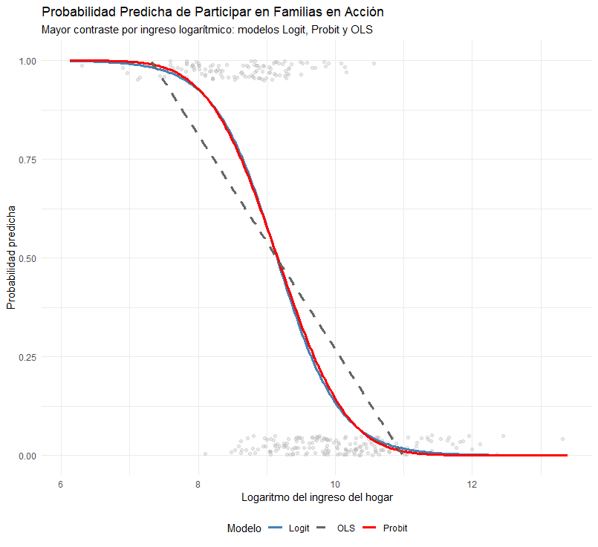
28/05/2026
Binomial Models
Predicted probability to partake in the Familias in acción conditional over income levels
Logit
Probit
Predicted probabilities
Linear probability
Income (in logarithms)
Notes:
No existe una forma cerrada para la función normal. Por eso:
Se deja expresada como una integral.
Su evaluación requiere métodos numéricos o tablas precomputadas.
En modelos probit, se usa esta forma acumulada para mapear el predictor lineal a una probabilidad.
Estas son funciones de distribucion acumulada.

Slide 15


Common models to study binary outcome variables
Métodos cuantitativos

Slide 16
Binomial models
The Logit Model

Slide 17
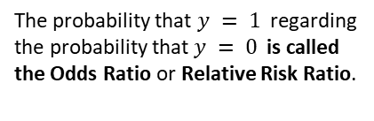
28/05/2026
The Logit Model
The logit model specification is:
Reordering
Shifting the numerator, to a denominator product, we get:
If we apply log to the expression, we get:
The product in the denominator turns into:
Using the fact that the fraction of a log is the difference of its term, we get:
Adding the exponent of common bases:
The probability that $y = 1$ regarding the probability that $y = 0$ is called the Odds Ratio or Relative Risk Ratio.
Notes:
No existe una forma cerrada para la función normal. Por eso:
Se deja expresada como una integral.
Su evaluación requiere métodos numéricos o tablas precomputadas.
En modelos probit, se usa esta forma acumulada para mapear el predictor lineal a una probabilidad.
Estas son funciones de distribucion acumulada.

Slide 18
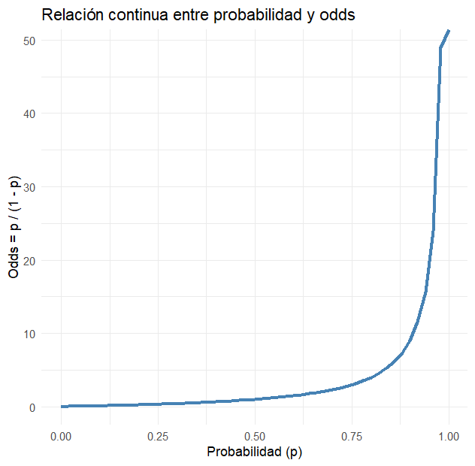
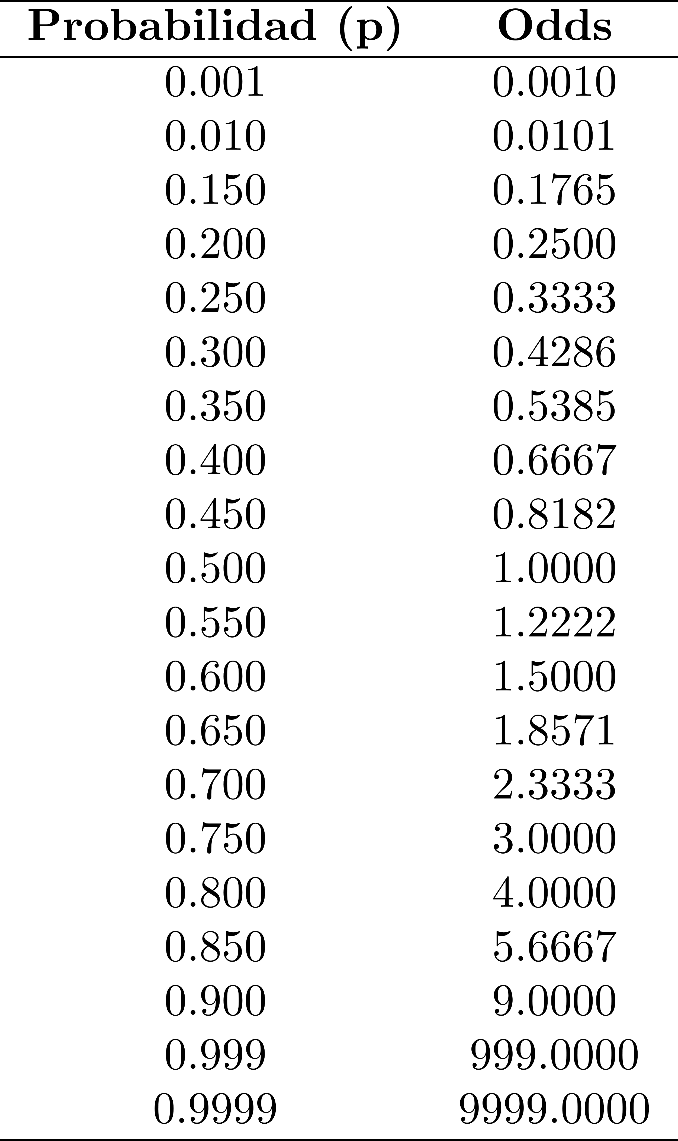
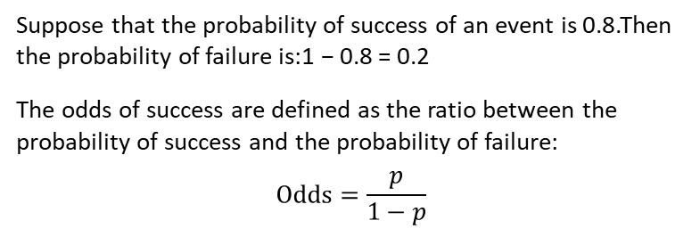
28/05/2026
The Logit Model
From
Probability → to odds → to log odds
Odds and Probability
Suppose that the probability of success of an event is 0.8.Then the probability of failure is:1 − 0.8 = 0.2
The odds of success are defined as the ratio between the probability of success and the probability of failure:
$$\text{Odds}=\frac{p}{1−p}$$
The transformation from probability to odds is monotonically increasing: as the probability increases, the odds also increase.
Additionally, probability is bounded between 0 and 1,whereas odds range from 0 to positive infinity.
Notes:
No existe una forma cerrada para la función normal. Por eso:
Se deja expresada como una integral.
Su evaluación requiere métodos numéricos o tablas precomputadas.
En modelos probit, se usa esta forma acumulada para mapear el predictor lineal a una probabilidad.
Estas son funciones de distribucion acumulada.

Slide 19
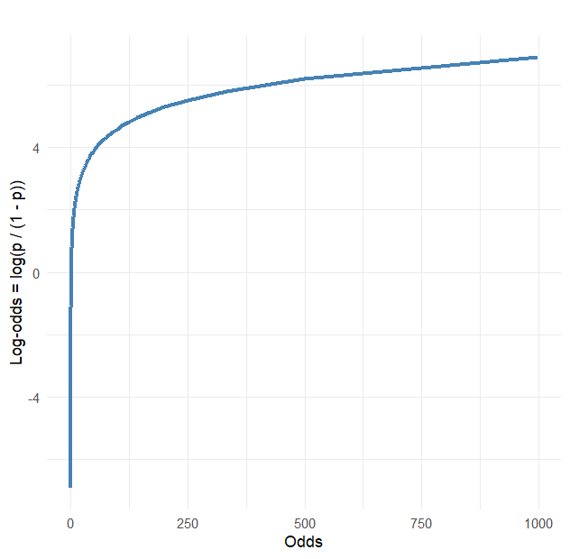
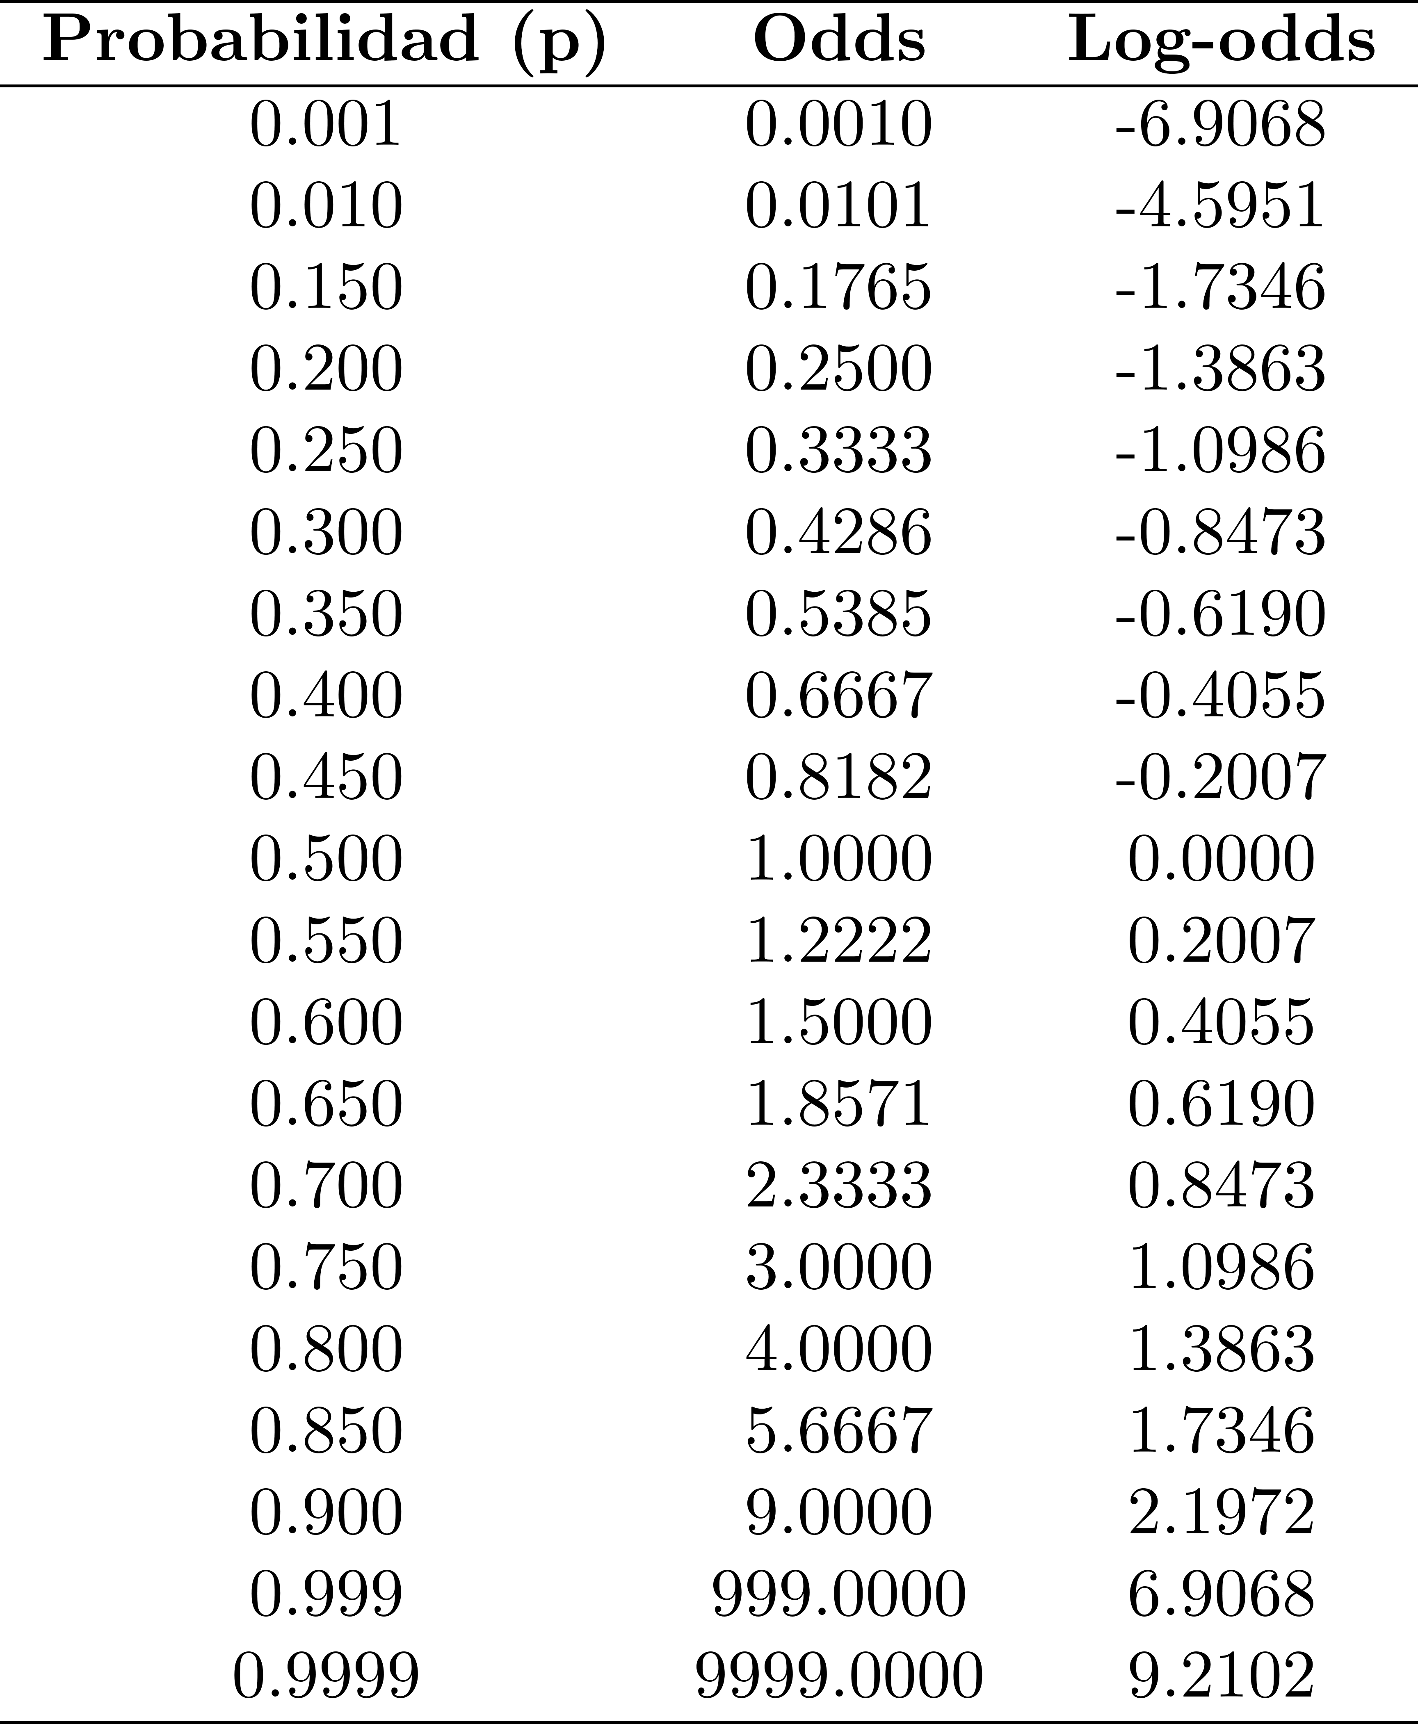
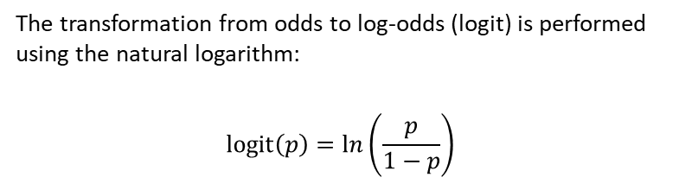
28/05/2026
The Logit Model
From
Probability → to odds → to log odds
Odds and Log Odds
The transformation from odds to log‑odds (logit) is performed using the natural logarithm:
$$\text{logit}\left(p\right)=\ln\left(\frac{p}{1−p}\right)$$
This transformation is also monotonically increasing: higher odds correspond to higher log‑odds.
Its usefulness lies in the fact that it converts a bounded variable(probability between 0 and 1) into an unbounded one(log‑odds range from −∞ to +∞), which simplifies statistical modelling.
Notes:
No existe una forma cerrada para la función normal. Por eso:
Se deja expresada como una integral.
Su evaluación requiere métodos numéricos o tablas precomputadas.
En modelos probit, se usa esta forma acumulada para mapear el predictor lineal a una probabilidad.
Estas son funciones de distribucion acumulada.

Slide 20
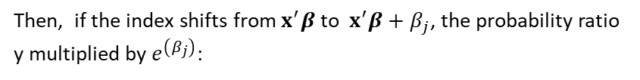

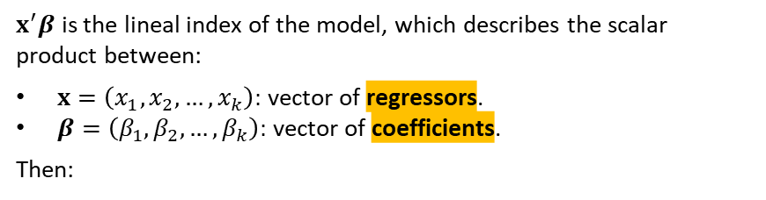
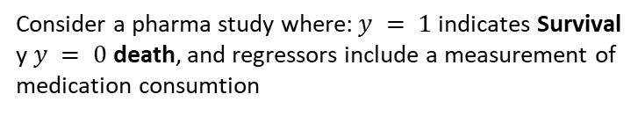
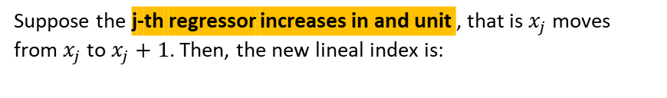
28/05/2026
The Logit Model
Consider a pharma study where:$y = 1$indicates Survival y $y = 0$death, and regressors include a measurement of medication consumtion
$x^{′}β$ is the lineal index of the model, which describes the scalar product between:
$x=\left(x_{1},x_{2},…,x_{k}\right):$ vector of regressors.
$β=\left(β_{1},β_{2},…,β_{k}\right):$ vector of coefficients.
Then:
The Odds Ratio is defined as:
Suppose the j-th regressor increases in and unit , that is $x_{j}$ moves from $x_{j}$ to $x_{j}+1$. Then, the new lineal index is:
Then, if the index shifts from $x^{′}β$ to $x^{′}β+β_{j}$, the probability ratio y multiplied by $e^{\left(β_{j}\right)}$:
In the logit model the odd ratio is linear in the regressors:
The Odds ratios increases by a factor of $e^{\left(β_{j}\right)}$
Notes:
No existe una forma cerrada para la función normal. Por eso:
Se deja expresada como una integral.
Su evaluación requiere métodos numéricos o tablas precomputadas.
En modelos probit, se usa esta forma acumulada para mapear el predictor lineal a una probabilidad.
Estas son funciones de distribucion acumulada.

Slide 21
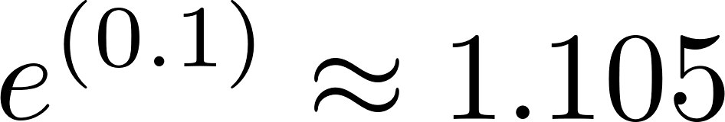
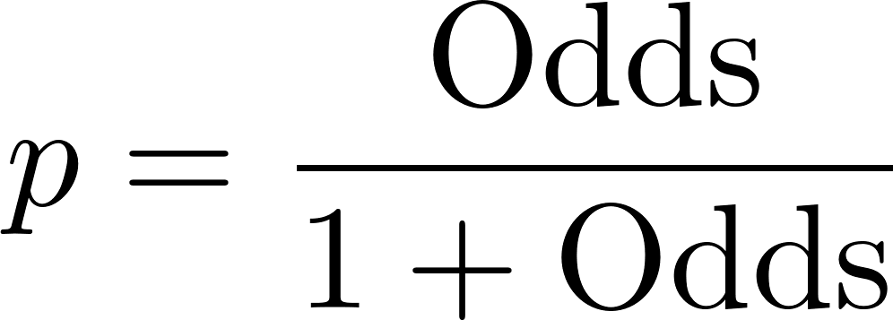
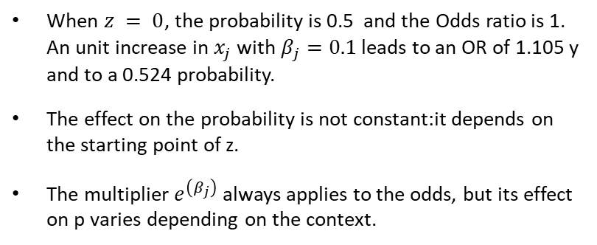
28/05/2026
The Logit Model
Therefore, a parameter of 0.1 means that an increase of one unit in the regressor multiplies the initial odds ratio by:
O$ne unit change impact over (x_{j})$with $(β_{j}=0.1)$
This means that the odds ratio increases by 1.105, that is, the relative probability of survival increases by 10.5%:
When $z = 0$, the probability is 0.5 and the Odds ratio is 1. An unit increase in $x_{j}$ with $β_{j}=0.1$ leads to an OR of 1.105 y and to a 0.524 probability.
The effect on the probability is not constant:it depends on the starting point of z.
The multiplier $e^{\left(β_{j}\right)}$always applies to the odds, but its effect on p varies depending on the context.
Although the odds increase by 10.5%, the probability p of survival does not increase by that same percentage, because the relationship between odds and probability is non‑linear:
Notes:
No existe una forma cerrada para la función normal. Por eso:
Se deja expresada como una integral.
Su evaluación requiere métodos numéricos o tablas precomputadas.
En modelos probit, se usa esta forma acumulada para mapear el predictor lineal a una probabilidad.
Estas son funciones de distribucion acumulada.

Slide 22
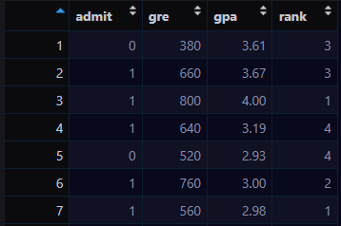
28/05/2026
The Logit Model
A researcher is interested in how variables such as GRE score (Graduate Record Examination), GPA (Grade Point Average), and the prestige of the undergraduate institution influence admission to postgraduate programmes.
The response variable, admitted/not admitted, is binary.
Admit. Dichotomous dependent variable indicating whether the person was admitted to the postgraduate programme.
GRE. Independent variable, integer numerical, describing the score obtained in the Graduate Record Examination.
GPA. Independent variable, discrete numerical variable describing the student’s cumulative academic average (Grade Point Average).
Rank. Ordinal variable describing the ranking of the university from which each student graduated.
Notes:
No existe una forma cerrada para la función normal. Por eso:
Se deja expresada como una integral.
Su evaluación requiere métodos numéricos o tablas precomputadas.
En modelos probit, se usa esta forma acumulada para mapear el predictor lineal a una probabilidad.
Estas son funciones de distribucion acumulada.

Slide 23
28/05/2026
The Logit Model
A researcher is interested in how variables such as GRE score (Graduate Record Examination), GPA (Grade Point Average), and the prestige of the undergraduate institution influence admission to postgraduate programmes.
The response variable, admitted/not admitted, is binary.
Notes:
No existe una forma cerrada para la función normal. Por eso:
Se deja expresada como una integral.
Su evaluación requiere métodos numéricos o tablas precomputadas.
En modelos probit, se usa esta forma acumulada para mapear el predictor lineal a una probabilidad.
Estas son funciones de distribucion acumulada.

Slide 24
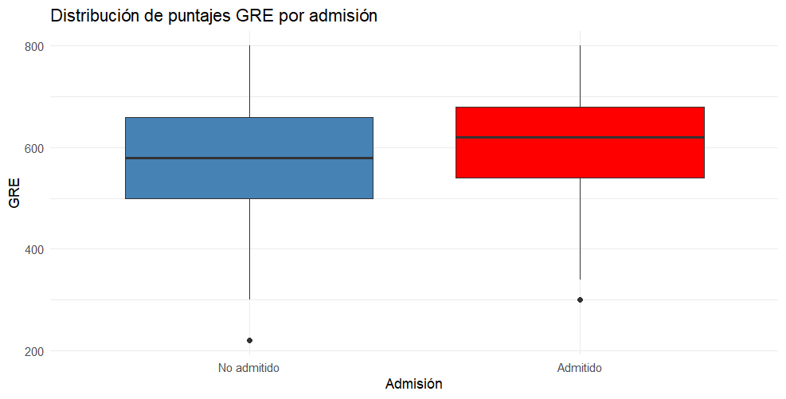
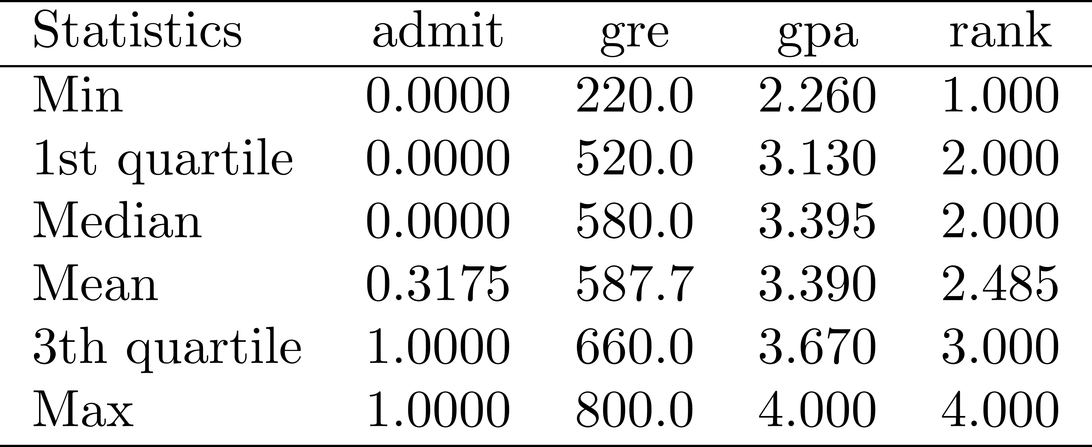
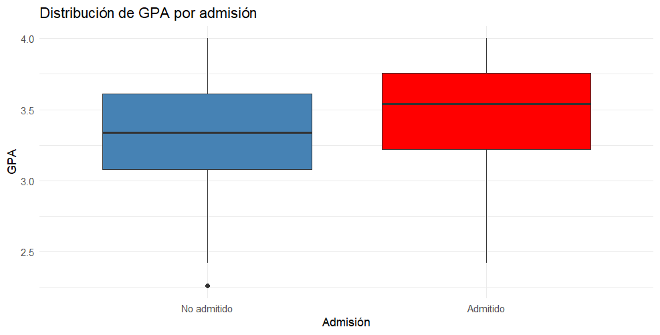
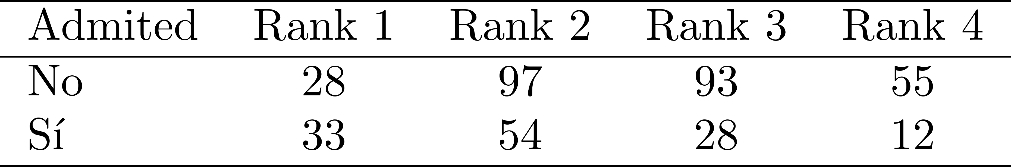
28/05/2026
The Logit Model
Before fitting the model, let us begin with an EDA using cross‑tabulations and sample statistics:
Distribution of GRE scores by admission
Descriptive statistics of the sample
Distribution of GPA scores by admission
Cross‑tabulation between the dependent variable and university rank
Notes:
No existe una forma cerrada para la función normal. Por eso:
Se deja expresada como una integral.
Su evaluación requiere métodos numéricos o tablas precomputadas.
En modelos probit, se usa esta forma acumulada para mapear el predictor lineal a una probabilidad.
Estas son funciones de distribucion acumulada.

Slide 25
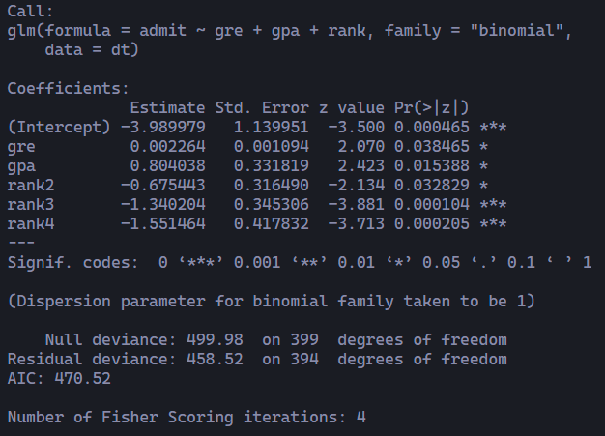
28/05/2026
The Logit Model
When estimating the model, we obtain:
Dependent variable
Independent variables
Link function
Generalised regression function
Two‑tailed p‑values, which evaluate the alternative hypothesis that each coefficient is different from zero.
To reject the null hypothesis associated with a coefficient, the p‑value must be smaller than α (usually 0.05).
Reference to the table that contains the data records
Estimated coefficients of the logit model. Their units are log‑odds and cannot be interpreted in the same way as OLS coefficients. To interpret them, one must:
compute odds ratios
evaluate predicted probabilities.
Statistic for testing whether each coefficient is different from zero. To reject the null hypothesis, the value of the statistic must be greater than the critical value associated with α (1.96 if the significance level is 0.05).
Degrees of freedom of the model: equal to the number of observations minus the number of estimated parameters.
Given 400 observations: the null model (no predictors) has 399 degrees of freedom, the model with controls has 396 degrees of freedom (400 minus the 4 parameters estimated).
Deviance of the null model (without predictors):indicates how well (or poorly) the model predicts the response variable without using the controls.
Higher values imply worse fit
Deviance of the model with predictors
AIC (Akaike Information Criterion): penalizes model complexity; lower AIC indicates a better balance between fit and parsimony.
Notes:
No existe una forma cerrada para la función normal. Por eso:
Se deja expresada como una integral.
Su evaluación requiere métodos numéricos o tablas precomputadas.
En modelos probit, se usa esta forma acumulada para mapear el predictor lineal a una probabilidad.
Estas son funciones de distribucion acumulada.

Slide 26
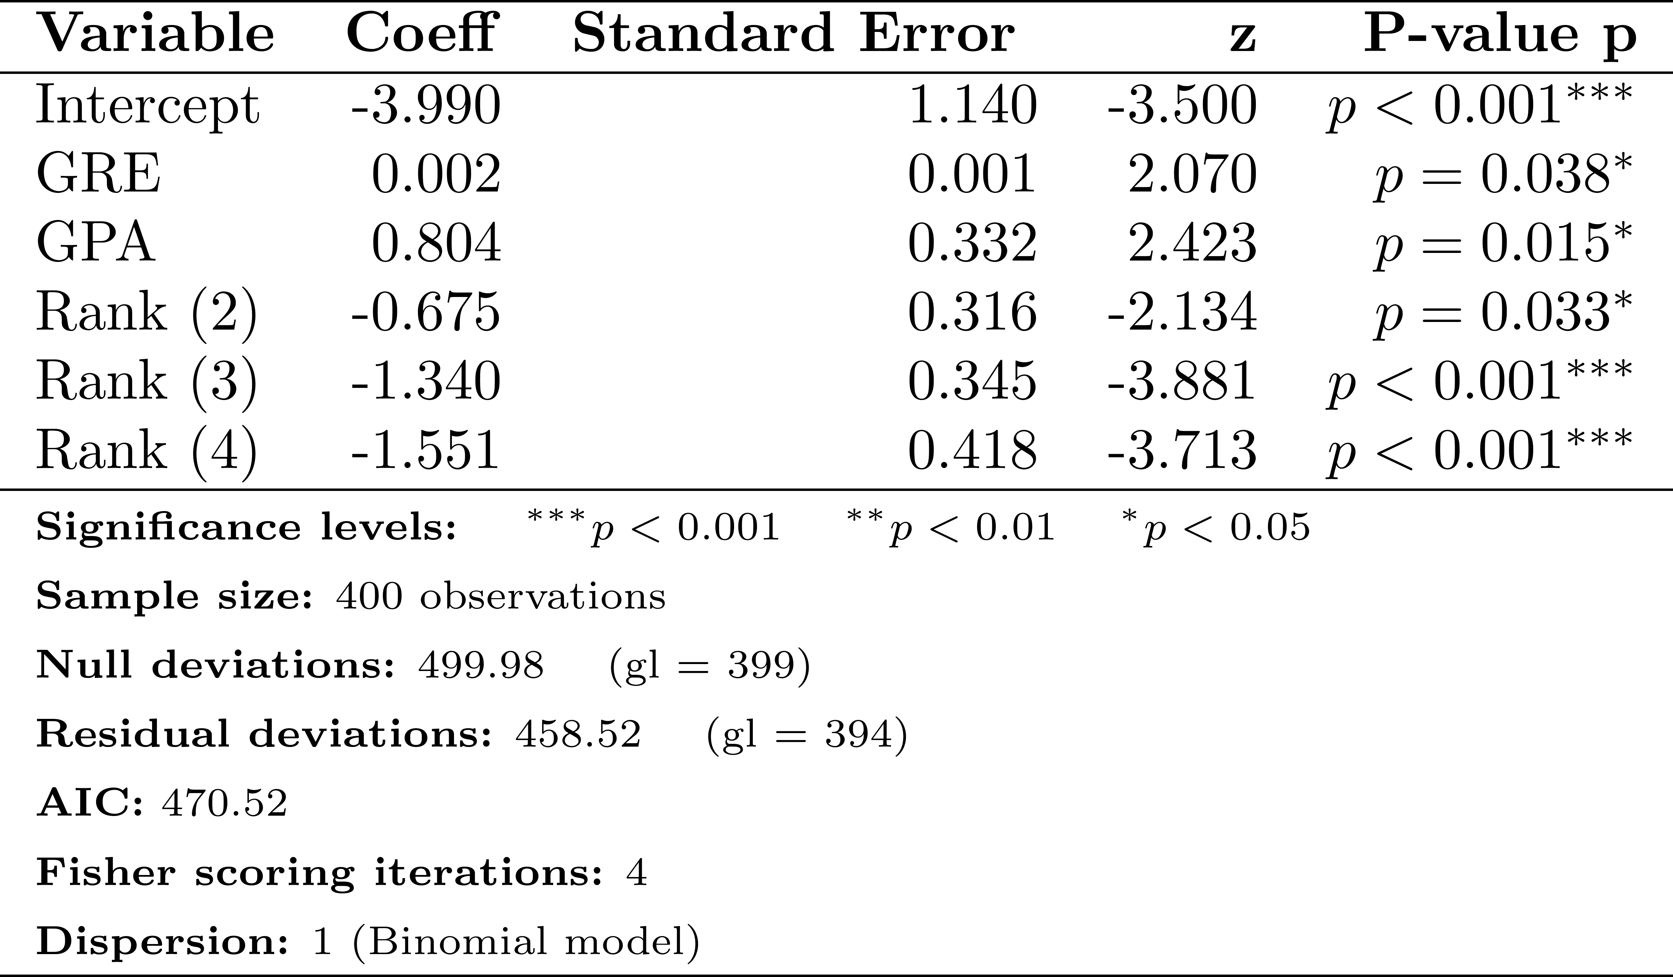
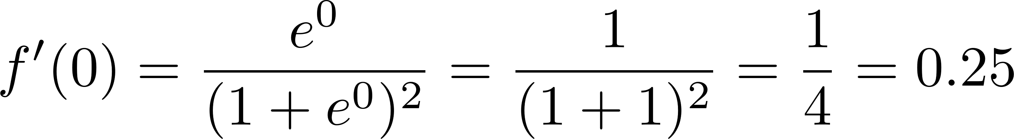
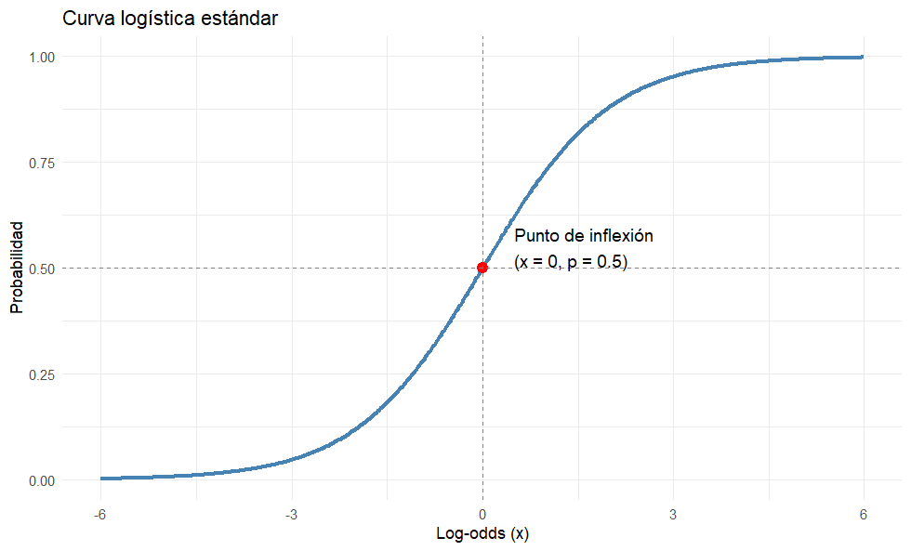

28/05/2026
The Logit Model
Results of the logistic regression regarding the probability of acceptance
The derivative if the logistic function $f\left(x\right)=\frac{1}{1+e^{−x}}$ reaches its maximum at $x = 0$, where:
This value represents the maximum change in probability resulting from a one‑unit change in the log‑odds, occurring exactly at the inflection point of the logistic curve.
When the model is near the centre of the distribution (probability ≈ 0.5), the change in probability may be approximated as:
For each additional unit in the GRE score, the log‑odds of admission (versus non‑admission) increase by 0.002.
For each additional unit in GPA, the log‑odds of being admitted to postgraduate studies increase by 0.804.
The indicator variables for institutional prestige have a slightly different interpretation.
For example, graduating from a Rank 2 institution, compared with a Rank 1 institution, reduces the log‑odds of admission by –0.675.
Notes:
No existe una forma cerrada para la función normal. Por eso:
Se deja expresada como una integral.
Su evaluación requiere métodos numéricos o tablas precomputadas.
En modelos probit, se usa esta forma acumulada para mapear el predictor lineal a una probabilidad.
Estas son funciones de distribucion acumulada.

Slide 27

28/05/2026
The Logit Model
Results of the logistic regression regarding the probability of acceptance
The derivative if the logistic function $f\left(x\right)=\frac{1}{1+e^{−x}}$ reachis its maximum at $x = 0$, where:
This value represents the maximum change in probability resulting from a one‑unit change in the log‑odds, occurring exactly at the inflection point of the logistic curve.
For each additional unit in the GRE score, the log‑odds of admission (versus non‑admission) increase by 0.002.
For each additional unit in GPA, the log‑odds of being admitted to postgraduate studies increase by 0.804.
The indicator variables for institutional prestige have a slightly different interpretation.
For example, graduating from a Rank 2 institution, compared with a Rank 1 institution, reduces the log‑odds of admission by –0.675.
The marginal effect of GRE is small: each additional GRE point increases the probability of admission by about 0.05% when the baseline probability is around 0.5
GPA has a large effect: a one‑unit increase in GPA raises the probability of admission by approximately 20 percentage points.
Institutional prestige reduces admission chances: moving from Rank 1 to Rank 4 decreases the probability of admission by nearly 39 percentage points, holding the other covariates constant.
Notes:
No existe una forma cerrada para la función normal. Por eso:
Se deja expresada como una integral.
Su evaluación requiere métodos numéricos o tablas precomputadas.
En modelos probit, se usa esta forma acumulada para mapear el predictor lineal a una probabilidad.
Estas son funciones de distribucion acumulada.

Slide 28
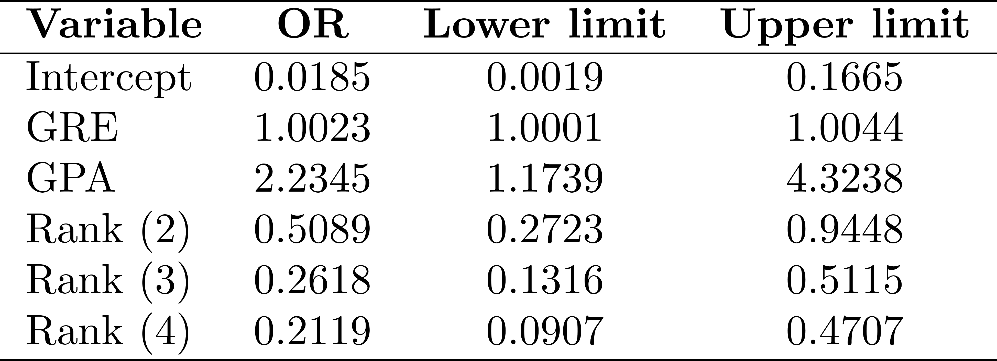
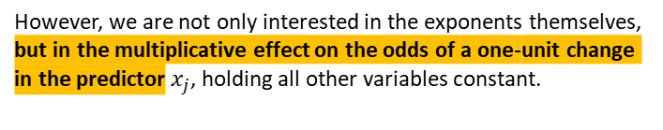
28/05/2026
The Logit Model
To interpret the results, we can (and should) also apply the exponential function to the estimated parameters to obtain the odds ratios (ORs):
GRE
1.
Odds ratio
The estimated coefficient for GRE is β = 0.0023, meaning that for each additional point in the GRE score, the log‑odds of being admitted increase by 0.0023 units. This translates into an odds ratio of:
However, we are not only interested in the exponents themselves, but in the multiplicative effect on the odds of a one‑unit change in the predictor $x_{j}$​, holding all other variables constant.
That is, a 0.23% increase in the odds of admission for every additional GRE point.
2.
0.25 rule
Results of the logistic regression regarding the probability of acceptance in terms of odds ratios (OR)
To get the maximum change in probability resulting from a one‑unit change in the log‑odds, we use the inflection point of the logistic curve.
This corresponds to an increase of about 0.0575 percentage points in the probability of admission per additional 10 GRE points, assuming the baseline probability is near 0.5.
Notes:
No existe una forma cerrada para la función normal. Por eso:
Se deja expresada como una integral.
Su evaluación requiere métodos numéricos o tablas precomputadas.
En modelos probit, se usa esta forma acumulada para mapear el predictor lineal a una probabilidad.
Estas son funciones de distribucion acumulada.

Slide 29
28/05/2026
The Logit Model
To interpret the results, we can (and should) also apply the exponential function to the estimated parameters to obtain the odds ratios (ORs):
GPA
1.
Odds ratio
The estimated coefficient for GPA is β = 0.084, meaning that for each additional point in the GRE score, the log‑odds of being admitted increase by 0.084 units. This translates into an odds ratio of:
However, we are not only interested in the exponents themselves, but in the multiplicative effect on the odds of a one‑unit change in the predictor $x_{j}$​, holding all other variables constant.
That is, a 123.45% increase in the odds of admission for every additional GRE point.
2.
0.25 rule
Results of the logistic regression regarding the probability of acceptance in terms of odds ratios (OR)
To get the maximum change in probability resulting from a one‑unit change in the log‑odds, we use the inflection point of the logistic curve.
This corresponds to an increase of about 20 percentage points in the probability of admission per additional 10 GPA points, assuming the baseline probability is near 0.5.
Notes:
No existe una forma cerrada para la función normal. Por eso:
Se deja expresada como una integral.
Su evaluación requiere métodos numéricos o tablas precomputadas.
En modelos probit, se usa esta forma acumulada para mapear el predictor lineal a una probabilidad.
Estas son funciones de distribucion acumulada.

Slide 30
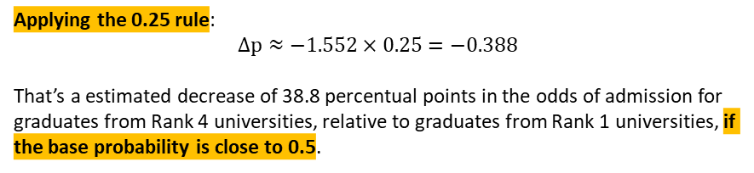
28/05/2026
The Logit Model
To interpret the results, we can (and should) also apply the exponential function to the estimated parameters to obtain the odds ratios (ORs):
Rank 4 vs 1
1.
Odds ratio
The estimated coefficient for Rank 4 is β = −1.552, which implies that having completed undergraduate studies at a Rank 4 institution, compared with a Rank 1 institution, reduces the log‑odds of admission by 1.552 units. This translates into an odds ratio of:
However, we are not only interested in the exponents themselves, but in the multiplicative effect on the odds of a one‑unit change in the predictor $x_{j}$​, holding all other variables constant.
The odds of admission decrease by about 78.81% when moving from a Rank 1 to a Rank 4 institution, holding all other variables constant.
A student graduation from a Rank 4 university has an odds of acceptance of 0.2119, relative to that of graduates from Rank 1 university.
Results of the logistic regression regarding the probability of acceptance in terms of odds ratios (OR)
For every 10 expected admissions for Rank 4 graduates, we would expect up to 47 admissions for Rank 1 graduates, keeping all other things constant.
Applying the 0.25 rule:
$$Δ\text{p}≈−1.552×0.25=−0.388$$
That’s a estimated decrease of 38.8 percentual points in the odds of admission for graduates from Rank 4 universities, relative to graduates from Rank 1 universities, if the base probability is close to 0.5.
Notes:
No existe una forma cerrada para la función normal. Por eso:
Se deja expresada como una integral.
Su evaluación requiere métodos numéricos o tablas precomputadas.
En modelos probit, se usa esta forma acumulada para mapear el predictor lineal a una probabilidad.
Estas son funciones de distribucion acumulada.

Slide 31
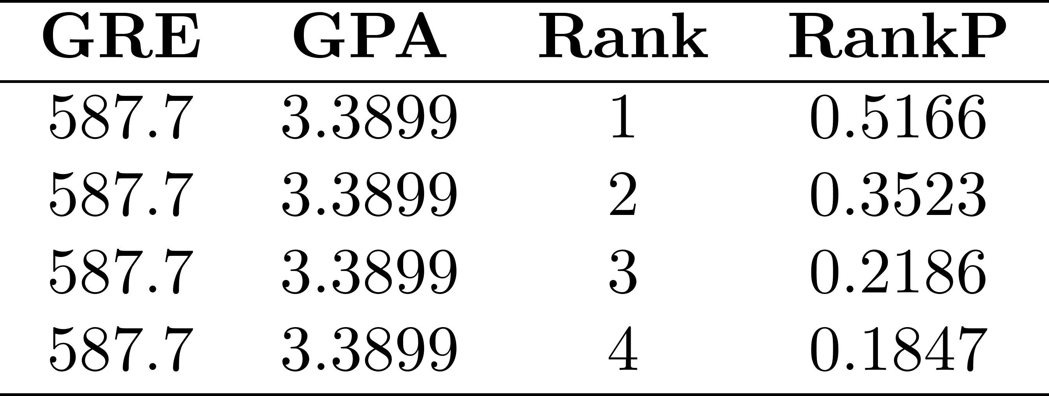
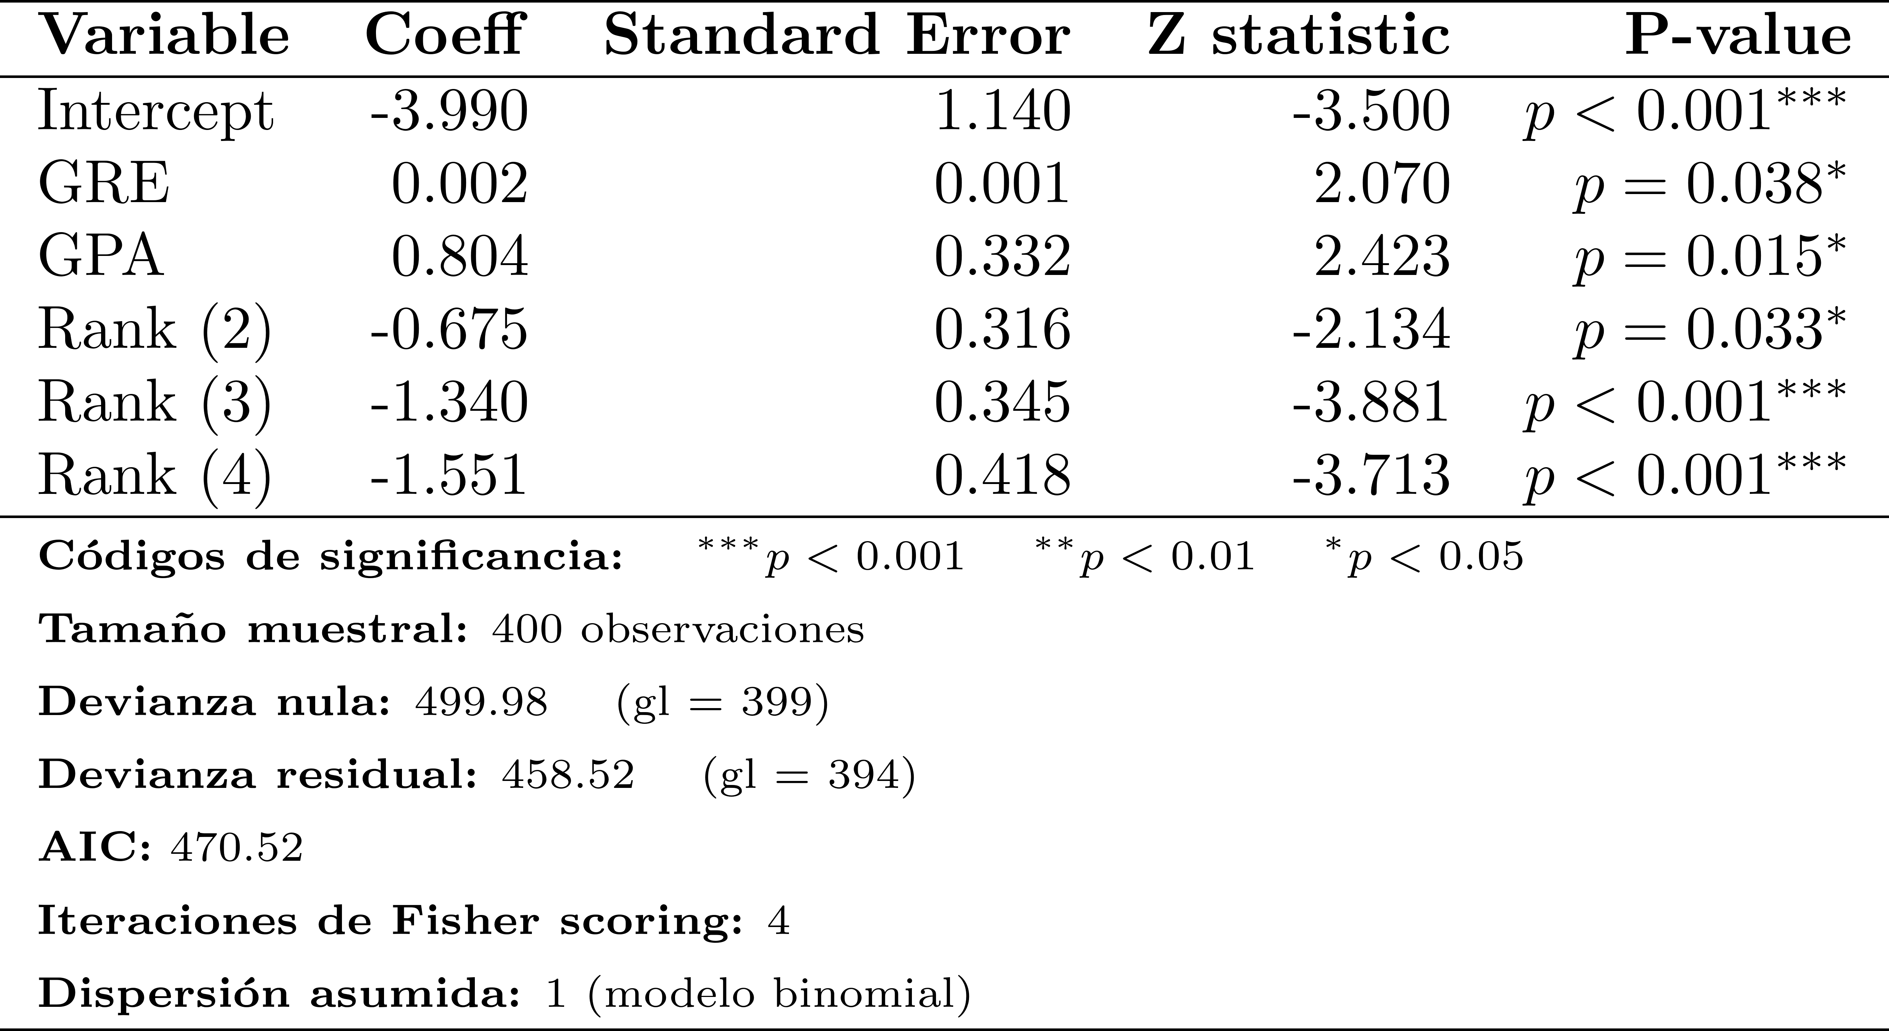
28/05/2026
The Logit Model
Build population profiles and to understand changes in probability based on average values of the control variables.
DV values and predicted probabilities of admission
Logit fit
31
Notes:
No existe una forma cerrada para la función normal. Por eso:
Se deja expresada como una integral.
Su evaluación requiere métodos numéricos o tablas precomputadas.
En modelos probit, se usa esta forma acumulada para mapear el predictor lineal a una probabilidad.
Estas son funciones de distribucion acumulada.

Slide 32
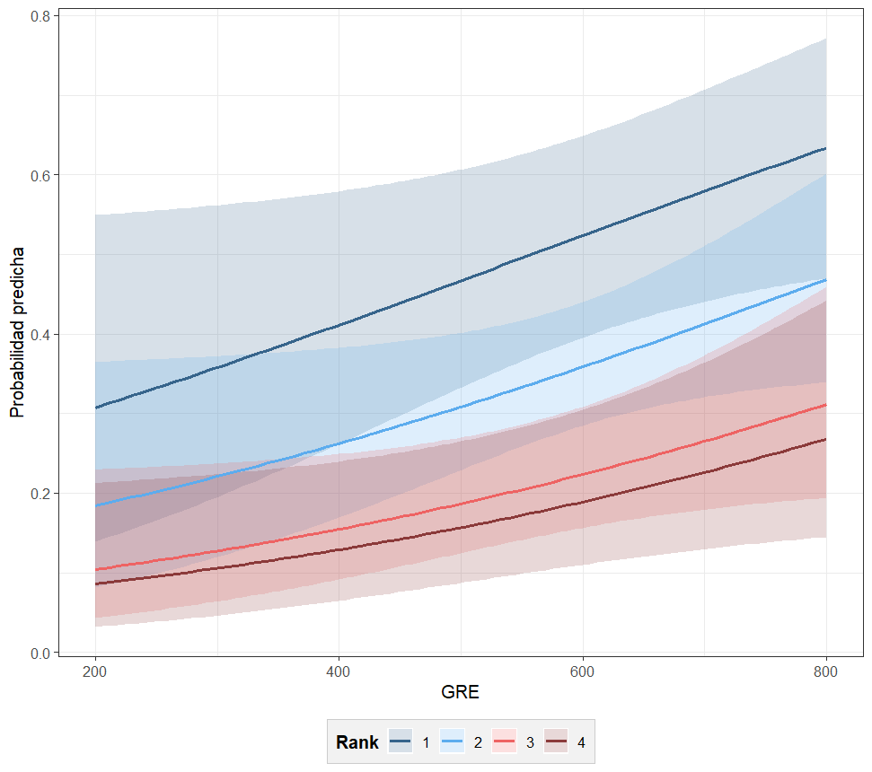
28/05/2026
The logit model
The logistic model not only allows us to estimate individual probabilities, but also to construct comparative profiles of admission. By keeping GPA constant and systematically varying GRE and Rank, we can identify concrete cases of admission probability.
Predicted probability of being admitted to a postgraduate programme, given University prestige levels, and GRE score
María
Rank: low
GRE: higher than the average mean 800
GPA: higher than the average mean 4
Admission probability : 37% (SE. 0.094)
Juan David
Rank: high
GRE: close to the average mean 600
GPA: lower than the average mean 3
Admission probability : 44% (SE. 0.074)
Notes:
No existe una forma cerrada para la función normal. Por eso:
Se deja expresada como una integral.
Su evaluación requiere métodos numéricos o tablas precomputadas.
En modelos probit, se usa esta forma acumulada para mapear el predictor lineal a una probabilidad.
Estas son funciones de distribucion acumulada.

